Slide 1
Chapter 2 Machine Instructions and Programs
Notes:
1

Slide 2
Objectives
Machine instructions and program execution, including branching and subroutine call and return operations.
Number representation and addition/subtraction in the 2’s-complement system.
Addressing methods for accessing register and memory operands.
Notes:
2

Slide 3
Number, Arithmetic Operations, and Characters
Notes:
3

Slide 4
Signed Integer Representations
3 major representations:
Sign and magnitude
One’s complement
Two’s complement
Assumptions for the Next Example:
4-bit machine word
16 different values can be represented
Roughly half are positive, half are negative
Notes:
4

Slide 5
Sign and Magnitude Representation
High order bit is sign: 0 = positive (or zero), 1 = negative
Three low order bits is the magnitude: 0 (000) thru 7 (111)
Number range for n bits = +/- (2^{n-1} - 1)
Problems: Two representations for 0 (0000 is +0, 1000 is –0) (see the number wheel)
Some Complexities in Addition, Subtraction
Notes:
5

Slide 6
One’s Complement Representation
- x = 1’s complement of x
1’s complement is invert 0 to 1 and 1 to 0
Two representations for 0 ( 0000 is +0, 1111 is -0). causes some problems Some complexities in addition, subtraction
Subtraction (X-Y) implemented by addition & 1's complement (x – y = X + 1’s complement of Y = X + Y' )
Notes:
6

Slide 7
Two’s Complement Representation
like 1's comp
except
negative numbers
shifted
one position
clockwise
- x = 2’s complement of x
2’s complement is just 1’s complement + 1
Only one representation for 0 ( 0000 => 1111+1 => 10000 => 0000 in 4 bits, ignore the carry out / MSB 1)
Addition, Subtraction Very Simple
Notes:
7

Slide 8
Binary, Signed-Integer Representations (Self Study)
Page 28
B
V
alues represented
Sign and
b
3
b
2
b
1
b
0
magnitude
1'
s complement
2'
s complement
0
1
1
1
+
7
+
7
+
7
0
1
1
0
+
6
+
6
+
6
0
1
0
1
+
5
+
5
+
5
0
1
0
0
+
4
+
4
+
4
0
0
1
1
+
3
+
3
+
3
0
0
1
0
+
2
+
2
+
2
0
0
0
1
+
1
+
1
+
1
0
0
0
0
+
0
+
0
+
0
1
0
0
0
-
0
-
7
-
8
1
0
0
1
-
1
-
6
-
7
1
0
1
0
-
2
-
5
-
6
1
0
1
1
-
3
-
4
-
5
1
1
0
0
-
4
-
3
-
4
1
1
0
1
-
5
-
2
-
3
1
1
1
0
-
6
-
1
-
2
1
1
1
1
-
7
-
0
-
1
Figure 2.1. Binary, signed-integer representations.
Notes:
8

Slide 9
2’s-Complement Add and Subtract Operations(Self Study)
(a)
0 0 1 0
(
+
2
)
(b)
0 1 0 0
(
+
4
)
Page 31
+
0 0 1 1
(
+
3
)
+
1 0 1 0
(
-
6
)
0 1 0 1
(
+
5
)
1 1 1 0
(
-
2
)
(c)
1 0 1 1
(
-
5
)
(d)
0 1 1 1
(
+
7
)
+
1 1 1 0
(
-
2
)
+
1 1 0 1
(
-
3
)
1 0 0 1
(
-
7
)
0 1 0 0
(
+
4
)
(e)
1 1 0 1
(
-
3
)
1 1 0 1
-
1 0 0 1
(
-
7
)
+
0 1 1 1
0 1 0 0
(
+
4
)
(f)
0 0 1 0
(
+
2
)
0 0 1 0
-
0 1 0 0
(
+
4
)
+
1 1 0 0
1 1 1 0
(
-
2
)
(g)
0 1 1 0
(
+
6
)
0 1 1 0
-
0 0 1 1
(
+
3
)
+
1 1 0 1
0 0 1 1
(
+
3
)
(h)
1 0 0 1
(
-
7
)
1 0 0 1
-
1 0 1 1
(
-
5
)
+
0 1 0 1
1 1 1 0
(
-
2
)
(i)
1 0 0 1
(
-
7
)
1 0 0 1
-
0 0 0 1
(
+
1
)
+
1 1 1 1
1 0 0 0
(
-
8
)
(j)
0 0 1 0
(
+
2
)
0 0 1 0
-
1 1 0 1
(
-
3
)
+
0 0 1 1
0 1 0 1
(
+
5
)
Figure 2.4. 2's-complement Add and Subtract operations.
Notes:
9

Slide 10
Overflow Condition - Add two positive numbers to get a negative number or two negative numbers to get a positive number
-1
+0
-1
+0
-2
1111
0000
+1
-2
1111
0000
+1
-3
1110
0001
-3
1110
0001
1101
+2
1101
+2
-4
0010
-4
0010
1100
0011
+3
1100
0011
+3
-5
1011
-5
0100
+4
1011
0100
+4
-6
1010
-6
1010
0101
+5
0101
+5
1001
0110
1001
0110
-7
1000
+6
-7
+6
0111
1000
0111
-8
+7
-8
+7
5 + 3 = -8
-7 - 2 = +7
0101 + 0011 = 1000
1001 + 1100 = 10111 => 0111
x
Notes:
10

Slide 11
Overflow Condition – Carry in to MSB ≠ Carry out from MSB
0 1 1 1←carry-in
0 1 0 1
0 0 1 1
1 0 0 0
1 0 0 0
1 0 0 1
1 1 0 0
1 0 1 1 1
5
3
-8
-7
-2
7
Overflow
Overflow
0 0 0 0
0 1 0 1
0 0 1 0
0 1 1 1
1 1 1 1
1 1 0 1
1 0 1 1
1 1 0 0 0
No overflow
5
2
7
-3
-5
-8
No overflow
Two Ways to detect Overflow: (1) when carry-in to the MSB (most significant bit) does not equal carry out from MSB
(2) Add two positive numbers to get a negative number
or, Add two negative numbers to get a positive number
Notes:
11

Slide 12
Memory Locations, Addresses, and Operations
Notes:
12

Slide 13
Memory Location, Addresses, and Operation
n
bits
Memory consists of many millions of storage cells, each of which stores 1 bit.
Data is usually accessed in n-bit groups, called a “word”.
n is called word length.
Typically n=32 or 64 bits etc. (such systems called 32-bit systems, like: 32-bit CPU or 64-bit OS)
first word
second word
•
•
•
i
th word
•
•
•
last word
Figure 2.5. Memory words.
Notes:
13

Slide 14
Memory Location, Addresses, and Operation
32-bit word length example
32 bits
•
•
•
b
31
b
30
b
1
b
0
Sign bit:
b
31
=
0
for positive numbers
b
31
=
1
for negative numbers
(a) A signed integer
8 bits
8 bits
8 bits/1 byte
8 bits
(or, 1 byte)
ASCII
ASCII
ASCII
ASCII
character
character
character
character
(b) Four characters
Notes:
14

Slide 15
Memory Location, Addresses, and Operation
To retrieve information from memory, either for one word or one byte (8-bit), addresses for each location needed.
Each byte (8-bit group) in the memory are addressable! => This is called byte addressable!
A k-bit addressed memory chip has 2^{k} memory locations, namely 0 – 2^{k}-1, called memory space. (example: 4 bit => addresses 0000 to 1111 = 0 to 15 = 0 to 2⁴-1)
1K(kilo)=2¹⁰=1024;1MB(Megabyte)=1024KB(kilobyte)=2¹⁰*2¹⁰=2²⁰bytes
1GB (Gigabytes)=1024Megabytes=2¹⁰*2²⁰bytes= 2³⁰bytes
24-bit memory:2²⁴= 2⁴*2²⁰=16*1Mega= 16M (1Mega=2²⁰)
32-bit memory: 2³² = 4GB (1GB (gigabytes) = 2³⁰ bytes 4GB=2³² bytes because 4G= 4*1G = 2²*2³⁰ = 2³²)
1T(tera)=2⁴⁰, (after this, peta=2⁵⁰,exa=2⁶⁰,zetta=2⁷⁰,yotta
Notes:
15

Slide 16
Memory Location, Addresses, and Operation
It is impractical to assign distinct addresses to individual bit locations in the memory.
The most practical assignment is to have successive addresses refer to successive byte locations in the memory byte-addressable memory.
Byte locations have addresses 0, 1, 2, … If word length is 32 bits (4 bytes), then successive words are located at
addresses 0, 4, 8,…
Notes:
16

Slide 17
Big-Endian and Little-Endian Assignment of Memory Addresses
Big-Endian: higher (bigger) byte addresses are used for the least significant
bytes of the word (hint: bigger address ends it (i.e. at rightmost / LSB)
Little-Endian: opposite ordering. lower byte addresses are used for the less significant bytes of the word
W
ord
address
Byte address
Byte address
0
0
1
2
3
0
3
2
1
0
4
4
5
6
7
4
7
6
5
4
•
•
•
•
•
•
2
k
-
4
2
k
-
4
2
k
-
3
2
k
-
2
2
k
-
1
2
k
-
4
2
k
-
1
2
k
-
2
2
k
-
3
2
k
-
4
(a) Big-endian assignment
(b) Little-endian assignment
Figure 2.7. Byte and word addressing.
Notes:
17

Slide 18
Memory Location, Addresses, and Operation
Ordering of bytes: Little endian and Big endian schemes
Word alignment
Words are said to be aligned in memory if they begin at a byte addr. that is a multiple of the num of bytes in a word.
16-bit word: word addresses: 0, 2, 4, 6, 8, …. bytes
32-bit word: word addresses: 0, 4, 8, 12, 16, …. bytes
64-bit word: word addresses: 0, 8,16, 24, 32, …. bytes
Access numbers, characters, and character strings
Notes:
18

Slide 19
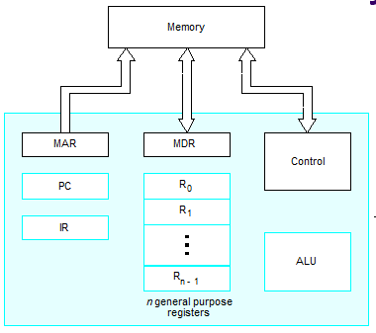
Memory Operation
LOAD (or Read or Fetch)
Copy content from memory to a Register. The memory content doesn’t change.
CPU places the sought address in MAR register, then places the RD control signal to the memory chip, then waits, until it receives the desired data into the MDR register
STORE (or Write)
Overwrite the content in memory
CPU Places the Address and Data in MAR and MDR registers, sends the WR control signal to the memory chip. Upon completion, the memory chip sends back MFC (Memory Function Complete) signal.
Notes:
19

Slide 20
Instruction and Instruction Sequencing
Notes:
20

Slide 21
“Must-Perform” Operations for a computer:
Data transfers between the memory and the processor registers
Arithmetic and logic operations on data
Program sequencing and control
I/O transfers
Notes:
21

Slide 22
Computer instructions must be capable of performing 4 types of operations:
i. Data transfer/movement between memory and processor registers.
E.g., memory read, memory write
ii. Arithmetic and logic operations:
E.g., addition, subtraction, comparison between two numbers.
iii. Program sequencing and flow of control:
Branch instructions
iv. Input/output transfers to transfer data to and from the real world.

Slide 23
Examples of different types of instructions in assembly language notation:
Data transfers between processor and memory:
Move A, B (B = A).
Move A, R1 (R1 = A).
Arithmetic and logic operation:
Add A, B, C (C = A + B)
Sequencing:
Jump Label (Jump to the subroutine which starts at Label).
Input/output data transfer:
Input PORT, R5 (Read from i/o port “PORT” to register R5).

Slide 24
Register Transfer Notation
Identify a location by a symbolic name standing for its hardware binary address (LOC, R0,…)
R0, R1, R2, .... => always indicates registers
Any other symbol => indicates memory location
Example: X, Y, Z, A, B, M, LOC, LOCA, LOCB
Contents of a location are denoted by placing square brackets around the name of the location (R1←[LOC], R3 ←[R1]+[R2])
Register Transfer Notation (RTN)
Notes:
24

Slide 25
Assembly Language Notation
Represent machine instructions and programs.
Opcode source_operand destination_operand
OP src_op dest_op
MOV LOC, R1 === equivalent ==> R1←[LOC]
ADD R1, R2, R3 =equivalent=> R3 ←[R1]+[R2]
Notes:
25

Slide 26
CPU Organization: Internal Storage Architecture:
Controls how its instructions use the operand(s).
The type of internal storage in a processor is the most basic differentiation.
i. Single Accumulator (AC) CPU Organization
One operand is implicitly the Accumulator Register.
The Accumulator is both an implicit input operand and a result.
Accumulator (AC) has to be saved to memory quite often.

Slide 27
ii. Register-Memory CPU Organization:
One input operand is a register, one is in memory and the result goes to a register.
It can access memory as part of any instruction.
iii. Register-Register/Load-Store CPU Organization:
All operands are registers.
It can access memory only with load and store instructions.

Slide 28
iv. Stack CPU Organization:
No Registers, but CPU-internal stack memory holds operands and result are always in the stack.
A Top of stack register (TOS) points to the top input operand, which is combined with the operand below. The first operand is removed from the stack, the result takes the place of the second operand and TOS is updated to point to the result.
All operands are implicit.

Slide 29
Instruction Formats
Three-Address Instructions
ADD R2, R3, R1 R1 ← R2 + R3
Two-Address Instructions
ADD R2, R1 R1 ← R1 + R2
One-Address Instructions (usually for Single Accumulator CPU organization): AC register is always an implicit operand
ADD M (AC ← AC+M[AR] (AC is the Accumulator Register))
Zero-Address Instructions (Usually for Stack CPU organization) No explicit operands, both operands are implicit
ADD (TOS ← TOS + (TOS – 1); TOS means Top of Stack)
RISC Instructions: An instruction can have 3~4 registers! Memory Access is restricted Only to LOAD and STORE instructions
Instruction
Opcode
Operand(s) or Address(es)

Slide 30
Instruction Formats
Example: Evaluate X ← (A+B) ∗ (C+D)
Three-Address Format
ADD A, B, R1 ; R1 ← M[A] + M[B]
ADD C, D, R2 ; R2 ← M[C] + M[D]
MUL R1, R2, X ; M[X] ← R1 ∗ R2

Slide 31
Instruction Formats
Example: Evaluate X←(A+B) ∗ (C+D)
Two-Address instruction format
MOV A, R1 ; R1 ← M[A]
ADD B, R1 ; R1 ← R1 + M[B]
MOV C, R2 ; R2 ← M[C]
ADD D, R2 ; R2 ← R2 + M[D]
MUL R2, R1 ; R1 ← R1 ∗ R2
MOV R1, X ; M[X] ← R1
Why not instructions like ADD A,B to make like B ← A+B
Because => both operands can’t be memory locations, at least one must be register. Besides the content of B should not be overwritten (the programmer knows nothing about this side effect!)

Slide 32
Instruction Formats***
Example: Evaluate X ← (A+B) ∗ (C+D)
One-Address Instruction Format
LOAD A ; AC ← M[A]
ADD B ; AC ← AC + M[B]
STORE T ; M[T] ← AC
LOAD C ; AC ← M[C]
ADD D ; AC ← AC + M[D]
MUL T ; AC ← AC ∗ M[T]
STORE X ; M[X] ← AC

Slide 33
Instruction Formats
Example: Evaluate X = (A+B) ∗ (C+D)
Zero-Address Instruction Format
(must use stack processor organization.
TOS means Top of Stack)
PUSH A ; TOS ← A
PUSH B ; TOS ← B
ADD ; TOS ← (A + B)
PUSH C ; TOS ← C
PUSH D ; TOS ← D
ADD ; TOS ← (C + D)
MUL ; TOS ←(C+D)∗(A+B)
POP X ; M[X] ← TOS

Slide 34
Instruction Formats
Example: Evaluate X = (A+B) ∗ (C+D)
RISC Instruction Format (i).RISC can use 3 registers in a single instruction; (ii).Only the LOAD and STORE instructions can access memory
LOAD A, R1 ; R1 ← M[A]
LOAD B, R2 ; R2 ← M[B]
LOAD C, R3 ; R3 ← M[C]
LOAD D, R4 ; R4 ← M[D]
ADD R1, R2, R1 ; R1 ← R1 + R2
ADD R3, R4, R3 ; R3 ← R3 + R4
MUL R1, R3, R1 ; R1 ← R1 ∗ R3
STORE R1, X ; M[X] ← R1

Slide 35
Using Registers
Registers are faster
Shorter instructions
The number of registers is smaller (e.g. 32 registers need 5 bits)
Potential speedup
Minimize the frequency with which data is moved back and forth between the memory and processor registers.
Notes:
35

Slide 36
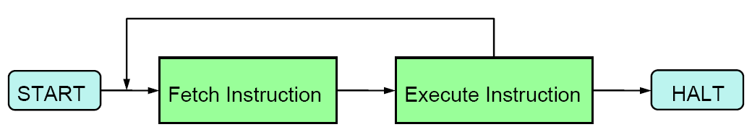
Instruction Execution
Basic instruction cycle

Slide 37
Straight-line sequencing
The processor control circuits use the information in the program counter (PC) to fetch and execute instructions, one at a time, in the order of increasing addresses.
This is called straight- line sequencing.

Slide 38
Instruction Execution and Straight-Line Sequencing
Assumptions:
- One memory operand
per instruction
- 32-bit word length
- Memory is byte
addressable
Each instruction fits in
ONE word (Full memory
address can be directly
specified in a single-word instruction
(though this is not realistic!!!)
Address
Contents
Begin execution here
i
Move
A,R0
3-instruction
i
+ 4
Add
B,R0
program
segment
i
+ 8
Move
R0,C
A
B
Data for
the program
Two-phase procedure
Instruction fetch
Instruction execute
C
Page 43
Figure 2.8. A program for C ← [Α] + [Β].
Notes:
38

Slide 39
Fetch/Execute cycle
Execution of an instruction takes place in two phases:
Instruction fetch.
Instruction execute.
Instruction fetch:
Fetch the instruction from the memory location whose address is in the Program Counter (PC).
Place the instruction in the Instruction Register (IR).
Instruction execute:
Instruction in the IR is examined (decoded) to determine which operation is to be performed.
Fetch the operands from the memory or registers.
Execute the operation.
Store the results in the destination location.
Basic fetch/execute cycle repeats indefinitely.

Slide 40
Branching
Branch instructions load a new value into the program counter.
As a result, the processor fetches and executes the instruction at this new address, called the branch target, instead of the instruction at the location that follows the branch instruction in sequential address order.

Slide 41
Conditional Branching
A conditional branch instruction causes a branch only if a specified condition is satisfied.
If the condition is not satisfied, the PC is incremented in the normal way, and the next instruction in sequential address order is fetched and executed.

Slide 42
Branching
i
Move
NUM1,R0
i
+
4
Add
NUM2,R0
i
+
8
Add
NUM3,R0
•
•
•
Adding An Array
Of Numbers
without Using
any Loop
(straight line program)
i
+
4
n
-
4
Add
NUM
n
,R0
i
+
4
n
Move
R0,SUM
•
•
•
SUM
NUM1
NUM2
•
•
•
NUM
n
Figure 2.9. A straight-line program for adding n numbers.
Notes:
42

Slide 43
Branching
Move
N,R1
Clear
R0
Branch target
LOOP
Determine address of
"Next" number and add
Program
"Next" number to R0
loop
Decrement
R1
Conditional branch
Branch>0
LOOP
Move
R0,SUM
•
•
•
SUM
N
n
NUM1
Figure 2.10. Using a loop to add n numbers.
NUM2
•
•
•
NUM
n
Notes:
43

Slide 44
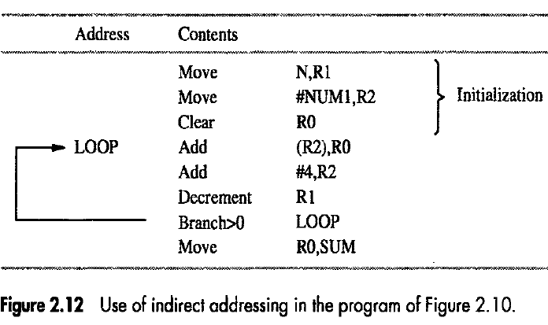
Book Examples (Fig. 2.12):
Indirect Addressing to
Compute the Array Sum
Move
N,R1
Clear
R0
LOOP
Determine address of
"Next" number and add
Program
"Next" number to R0
loop
Decrement
R1
Branch>0
LOOP
Move
R0,SUM
•
•
•
SUM
N
n
NUM1
NUM2
•
•
•
NUM
n
Notes:
44

Slide 45
Book Examples (Fig. 2.12): Indirect Addressing to Compute the Array Sum (Fig. 2.10)

Slide 46
Condition Codes / Status flags
Condition code flags (Status flags) of the CPU
Condition code flags are the bits of a special register (i.e., status register) within the processor. They are affected by the most recent ALU operations
N (negative) or S (sign) flag (i.e., bit of the status register) is Set to 1 if the result of most recent arithmetic operation is negative
Is used by some instructions, such as: Branch<0 LOOP
Z (zero) flag: is set if the result of the most recent arithmetic operation is ZERO
Used by some instructions, like: Branch==0 LABEL
C (carry) flag is set if a carry out from most recent operation
V (Overflow flag) is set if Overflow occurs in most recent op.
Different instructions affect different flags
Notes:
46

Slide 47
Example: How Condition Codes or Status Flags Set/Reset
A: 1 1 1 1 0 0 0 0
Example:
A: 1 1 1 1 0 0 0 0
B: 0 0 0 1 0 1 0 0
A = -16; B=20
So, A – B = -36
16 = 0001 0000
-16 = 2’s complement of 16
= 1111 0000
Subtract B ➔ Add (–B) = Add 2’s complement of B
= 1110 1100
+(−B): 1 1 1 0 1 1 0 0
1 1 1 0 1 1 1 0 0
C = 1
Z = 0
S = 1
V = 0

Slide 48
Addressing Modes
Programmers use data structures to represent the data used in computations. These include lists, linked lists, array, queues, and so on
A high-level language enables the programmer to use constants, local and global variables, pointers, and arrays
When translating a high-level language program into assembly language, the compiler must be able to implement these constructs using the facilities in the instruction set of the computer
The different ways in which the location of an operand is specified in an instruction are referred to as addressing modes

Slide 49
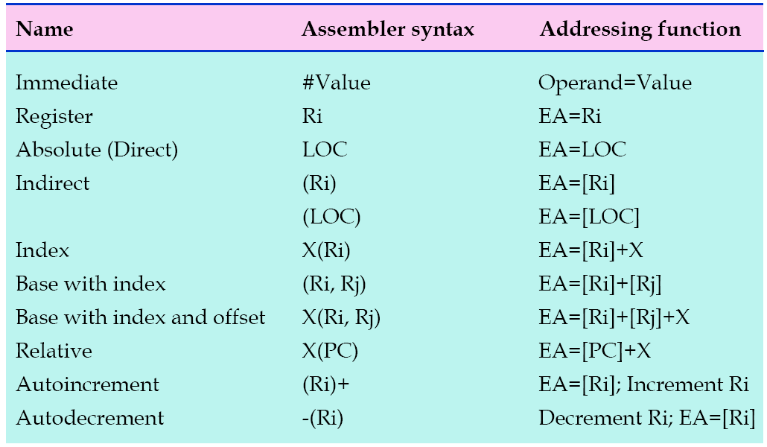
Generic Addressing Modes

Slide 50
Addressing modes
Different ways in which the address of an operand is specified in an instruction is referred to as addressing modes.
Register mode
Operand is the contents of a processor register.
Address of the register (its Name) is given in the instruction.
E.g. Clear R1 or Move R1, R2
Absolute mode
Operand is in a memory location.
Address of the memory location is given explicitly in the instruction.
E.g. Clear A or Move LOC, R2
Also called as “Direct mode” in some assembly languages
Register and absolute modes can be used to represent variables

Slide 51
Addressing modes (contd..)
Immediate mode
Operand is given explicitly in the instruction.
E.g. Move #200, R0
Can be used to represent constants.
Register, Absolute and Immediate modes contained either the address of the operand or the operand itself.
Some instructions provide information from which the memory address of the operand can be determined
That is, they provide the “Effective Address” of the operand.
They do not provide the operand or the address of the operand explicitly.
Different ways in which “Effective Address” of the operand can be generated.

Slide 52
Indirection and Pointers
Indirect mode: the effective address of the operand is the contents of a register or memory location whose address appears in the instruction
Indirection is denoted by placing the name of the register or the memory address given in the instruction in parentheses
The register or memory location that contains the address of an operand is called a pointer

Slide 53
Addressing modes (contd..)
Effective Address of the operand is the contents of a register or
a memory location whose address appears in the instruction.
Add (R1),R0
Add (A),R0
Main
memory
B
Operand
A
B
R1
B
Register
B
Operand
Register R1 contains Address B
Address A contains Address B
Address B has the operand
Address B has the operand
R1 and A are called “pointers”
This is called as “Indirect Mode”

Slide 54
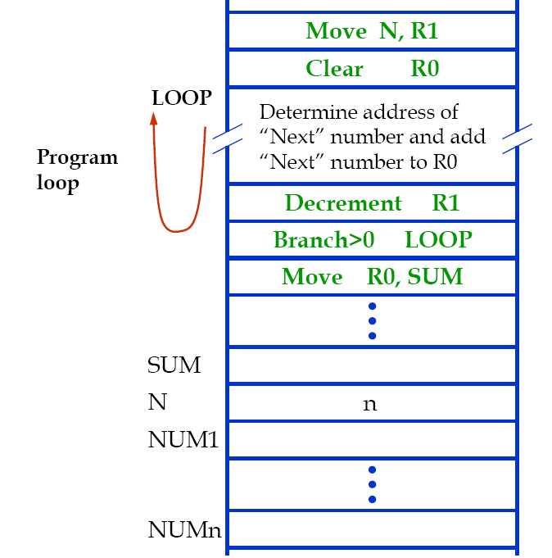
Using Indirect Addressing in a Program

Slide 55
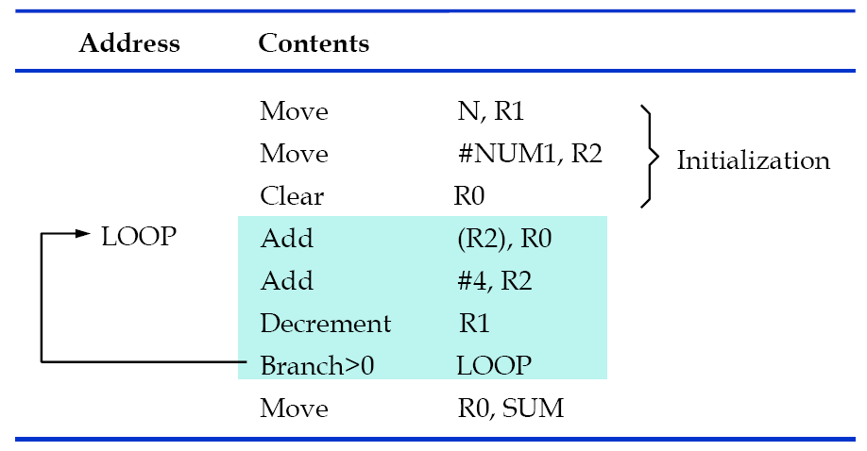
Using Indirect Addressing in a Program

Slide 56
Indexing and Arrays
Index mode: the effective address of the operand is generated by adding a constant value to the contents of a register
The register used may be either a special register provided for this purpose, or, more commonly, it may be any one of a set of general purpose registers in the processor.
It is referred to as an index register

Slide 57
Indexing and Arrays
The index mode is useful in dealing with lists and arrays
We denote the Index mode symbolically as X(Ri), where X denotes the constant value contained in the instruction and Ri is the name of the register involved.
The effective address of the operand is given by EA=X+(Ri).
The contents of the index register are not changed in the process of generating the effective address

Slide 58
Addressing modes (contd..)
Effective Address of the operand is generated by adding a constant
value to the contents of the register
Add 20(R1),R0
Operand is at address 1020
Register R1 contains 1000
Offset 20 is added to the
contents of R1 to generate the
address 1020
Contents of R1 do not change in the
process of generating the address
R1 is called as an “index register”
1000
offset = 20
1020
Operand
What address would be generated
by Add 1000(R1), R0 if R1 had 20?
R1
1000
This is the “Indexing Mode”

Slide 59
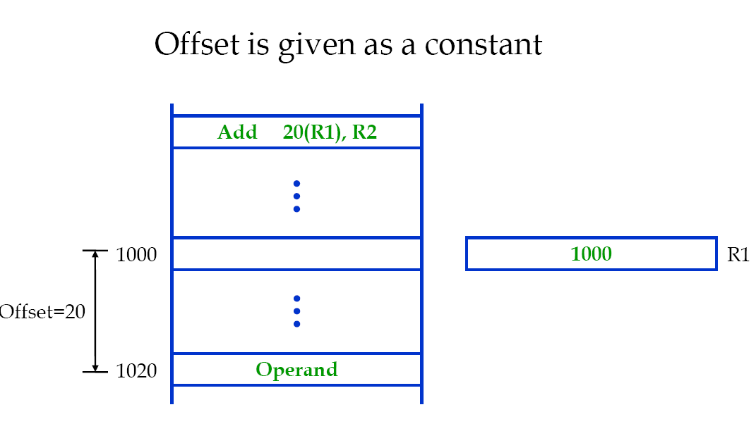
Indexed Addressing

Slide 60
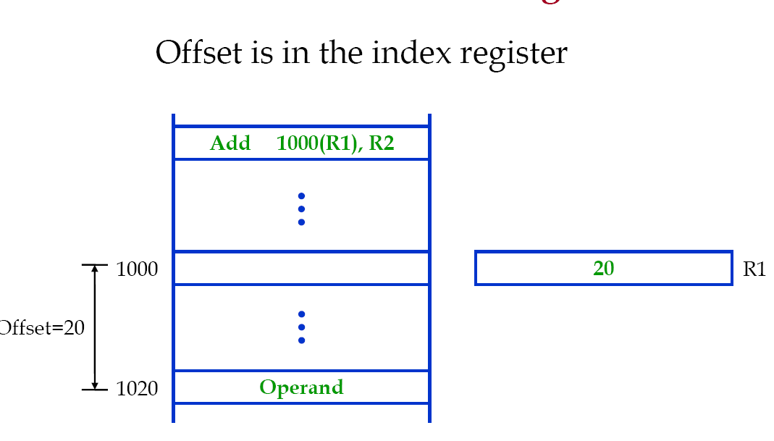
Indexed Addressing

Slide 61
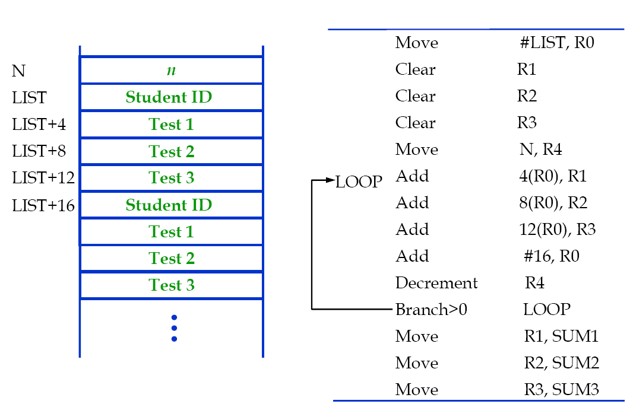
An Example for Indexed Addressing

Slide 62
Variations of Indexed Addressing Mode
A second register may be used to contain the offset X, in which case we can write the Index mode as (Ri,Rj)
The effective address is the sum of the contents of registers Ri and Rj
The second register is usually called the base register
This mode implements a two-dimensional array
Another version of the Index mode use two registers plus a constant, which can be denoted as X(Ri,Rj)
The effective address is the sum of the constant X and the contents of registers Ri and Rj
This mode implements a three-dimensional array

Slide 63
Relative mode
Effective Address of the operand is generated by adding a constant value to the contents of the Program Counter (PC).
Variation of the Indexing Mode, where the index register is the PC instead of a general purpose register.
When the instruction is being executed, the PC holds the address of the next instruction in the program.
Useful for specifying target addresses in branch instructions.
Addressed location is “relative” to the PC, this is called “Relative Mode”

Slide 64
Addressing Modes (contd..)
Relative mode:
The Instruction Branch > 0 Loop
Suppose that the loop starts at address 1000, and the branch instruction at address 1012.
The PC value now is 1016.
To branch to location Loop (1000), the offset value is 1000 – 1016 = -16
When the assembler processes such instruction, it computes the required offset value, and generates the corresponding machine instruction using the addressing mode:
-16(PC)

Slide 65
Addressing Modes (contd..)
Autoincrement mode:
Effective address of the operand is the contents of a register specified in the instruction.
After accessing the operand, the contents of this register are automatically incremented to point to the next consecutive memory location.
(R1)+
Autodecrement mode
Effective address of the operand is the contents of a register specified in the instruction.
Before accessing the operand, the contents of this register are automatically decremented to point to the previous consecutive memory location.
-(R1)
Autoincrement and Autodecrement modes are useful for implementing “Last-In-First-Out” data structures.

Slide 66
Addressing modes (contd..)
Implicitly the increment and decrement amounts are 1.
This would allow us to access individual bytes in a byte addressable memory.
Recall that the information is stored and retrieved one word at a time.
In most computers, increment and decrement amounts are equal to the word size in bytes.
E.g., if the word size is 4 bytes (32 bits):
Autoincrement increments the contents by 4.
Autodecrement decrements the contents by 4.

Slide 67
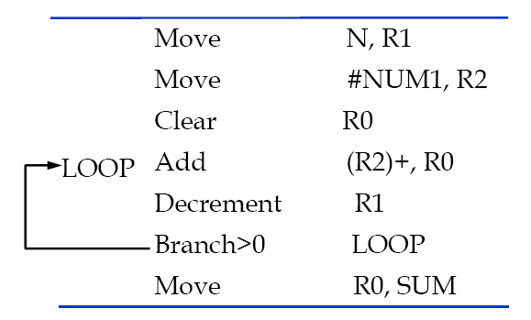
An Example of Autoincrement Addressing

Slide 68
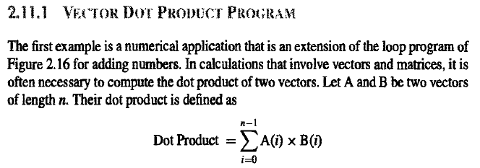
Book Examples (Fig. 2.33): Computing Dot Product of two vectors ... (1)

Slide 69
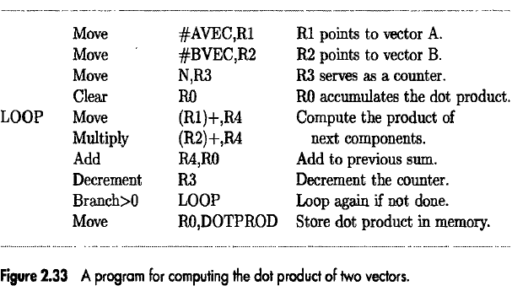
Book Examples (Fig. 2.33): Computing Dot Product of two vectors ... (2)

